Slide 1

Think Like a Scientist!
Nature of Science
Big Idea 1: The Practice of Science
Big Idea 2: The Characteristics of Scientific Knowledge
M&M’s Scientific Investigation
Notes:
Use this power point, Think Like a Scientist: M&M’s Scientific Investigation to Teach the Scientific Method.

Slide 2
Grade 5 Pacing Guide Topic 2:
Thinking Like a Scientist
SC.5.N.1.1 Define a problem, use appropriate reference materials to support scientific understanding, plan and carry out scientific investigations of various types such as: systematic observations, experiments requiring the identification of variables, collecting and organizing data, interpreting data in charts, tables, and graphics, analyze information, make predictions, and defend conclusions. AA
SC.5.N.2.1 Recognize and explain that science is grounded in empirical observations that are testable; explaining must always be linked with evidence. AA
SC.5.N.2.2 Recognize and explain that when scientific investigations are carried out, the evidence produced by those investigations should be replicable by others. AA
SC.5.P.8.1 Compare and contrast the basic properties of solids, liquids, and gases, such as mass, volume, color, texture, and temperature.
MACC.5.MD.1.2 Make a line plot to display a data set of measurements in fractions of a unit (1/2, 1/4, 1/8). Use operations on fractions for this grade to solve problems involving information presented in line plots. For example, given different measurements of liquid in identical beakers, find the amount of liquid each beaker would contain if the total amount in all the beakers were redistributed equally.
Department of Mathematics and Science

Slide 3
Notes:
Engage: Have students sing the rap to identify key steps in the scientific method. Students share out.

Slide 4

THE SCIENTIFIC METHOD
A process or steps scientists can use
to gather information and answer questions!
Notes:
Engage/Explore: play the video clip. Ask students to define the scientific method in one sentence in their notebooks. Share out and discuss. Then click to reveal one way to define it.

Slide 5
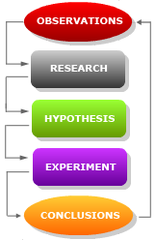
Scientific Method Overview
Make Observations
Ask questions
Do Background Research
Form a Hypothesis that is Testable
Experiment to Test your Hypothesis
Analyze Results & Draw Conclusions
Notes:
Ask students to name the steps.

Slide 6


Scientific Method
Study Jams – Scientific Method
Video & Karaoke Song
Scientific Methods
Learn how to think and solve problems like a
scientist when Tim and Moby explore scientific
methods in this Brain POP movie.
Notes:
Hyperlinks to Online resources

Slide 7
Step 1: Make an Observation to Identify a Problem
Make an observation using your senses.
Identify one question that
can be answered by
performing an experiment.
An experiment is a set of steps you follow to test a hypothesis.
This question will be the Problem Statement.
Notes:
Discuss

Slide 8

Step 2: Make a Hypothesis
Look at the Problem Statement and identify the one factor that can be tested. This is the manipulated or independent variable.
Form an idea or educated prediction that can be tested by an experiment.
Write down your Hypothesis: “If (I do this) then (this) will happen.”
Notes:
Discuss

Slide 9
Step 3: Plan and Design the Investigation
Identify and record the factors that can affect
the results of the experiment under Variables.
1. Test (independent/manipulated) variable or the factor that is changed in the experiment.
(See previous Step 3.)
2. Constant variables or all the factors to be kept the same (controlled) in the experiment.
3. Outcome (dependent/responding) variable or the data to be collected during the experiment.
4. Control Group (not found in all experiments) -
A group that is untreated by the factor being tested
that serves as a reference for comparison to the
experimental group.
Notes:
Discuss

Slide 10
Step 4: Planning Continued
Write your procedures or the steps you will
follow in your experiment.
Each procedure step needs to be numbered.
Each step needs to begin with a verb.
These procedures will insure that all variables are kept the same (constant) or controlled except the one you are testing (independent).
Identify control group = what remains the same (not the test variable).
Figure out and collect the materials needed for the experiment.
Notes:
Discuss

Slide 11
Step 5: Collect, Organize, and Display Data
Start the experiment.
Observe and record the quantitative data (numbers or measurements) collected during the experiment on a data table. (evidence)
Repeat the experiment three or more times to confirm results.
Take pictures during the experiment.
Graph your data from all trials. (Dry Mix)
Display under Data.
Restate your data in a narrative form under results.
Notes:
Discuss

Slide 12

Step 6:
Drawing Conclusions
What was investigated? (Describe the problem statement.)
Restate your hypothesis, and tell if it was supported(true) or not supported (false).
What were the major findings – the evidence ? (Explain your results.)
Look at everything that may have affected your results. What possible explanation can you offer for your findings?
Notes:
Discuss

Slide 13
Step 7:
Making Applications
What recommendations do you have for further study and for improving the experiment?
Explain what you learned from your experiment that could be applied in real life.
List any new question(s) that your experiment lead you to ask that could be tested in a new investigation.
Notes:
Discuss

Slide 14




Mysterious M&M’s
Take a closer look at an M&M
1. What are some things you observe about an M&M?
Record your observations in your notebook.
2. Talk in your group and discuss some of the properties you
observed about the M&M’s.
3. Do you have both Qualitative and Quantitative Observations?
4. Break open the M&M and look inside.
5. Describe what you observe in words and make a drawing to
show what the inside of the M&M looks like.
Adapted from Inquiry in Action Chapter 1 Activity 1.1
Notes:
Explore: Distribute an M&M to each student. As students begin to explore the characteristics of an M&M, listen to the conversations that student groups are having. Students should identify properties such as the following:
Size, shape, color, and texture
Different colored layers on the inside
Explain to students that their descriptions of M&M’s are all properties of M&M’s. Read the story from the Student Activity sheet, (see next slide) the student noticed that the color came off of an M&M when it fell in the water. Ask students if they ever had their M&M’s get wet and start to lose their color.
You can click on the hyperlink: Adapted from Inquiry in Action Chapter 1 Activity 1.1 for the original lesson.

Slide 15




An M&M Experience
Sometimes you can learn a lot about something by looking at it very closely or in ways you haven’t looked at it before. You may even discover things kind of by accident.
This is what happened to me the other day when I was eating some M&M’s and drinking a cup of water. I was almost done when one of my M&M’s fell into the water that was left in my cup. I didn’t care too much because I could eat that one even though it was wet. I decided to eat it but when I began to reach into the cup to take it out, I was kind of surprised by what I saw. There was an area of color in the water around the M&M, which I guess had dissolved into the water.
Notes:
Explore continued: Tell students that in the Try this activity, they will see what happens to the sugar and color coating of an M&M when it is placed in a plate of water. Have students place an M&M in a dish of water and observe.
Giving students an opportunity to observe an M&M in water will give them the context and motivation to want to find out more about how M&M colors look when they dissolve in water. From this experience, you can get them to ask questions that they can investigate. Students will conduct the following procedure and record their observations.
Procedure
Pour enough room-temperature water into a white plastic or foam plate so that the water is deep enough to completely cover an M&M.
Once the water has settled, place 1 M&M in the center of the plate. Be careful to keep the water and M&M as still as possible. Observe for about 1 minute.

Slide 16

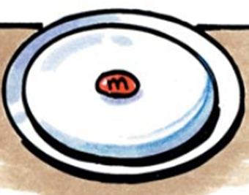
Mysterious M&M’s
Let’s try placing an M&M in water to get a better idea
of what the student in the story observed.
Read the procedures on the lab sheet.
What materials will be needed for each group ?
- container of room temperature water
- one M&M
- white foam plate
Follow the procedures #’s 1 - 3.
Discuss your group’s observations.
What do you notice about the movement of the
color from the M&M?
Notes:
Explore/Explain: Have students compare their results.
Ask students: what do they notice about the movement of the color from their M&M? What questions do they have?
Expected results: Each colored coating of M&M will dissolve in a circular pattern around the M&M. Students may also mention the white streaks in the water from the sugar coating. If anyone notices differences such as “the color moved over to one side more than the other,” check to see that the plate is level.
Point out to students that because the water makes the colored coating come off the M&M and mix into the water, the water is dissolving the sugar and color. Because the colored coating on M&M’s dissolves in a similar pattern each time one is placed in water, this is a characteristic property of the M&M coating.
Empty the plate of water and M&M into a bucket, bowl, or sink. Dry the plate with a paper towel.

Slide 17


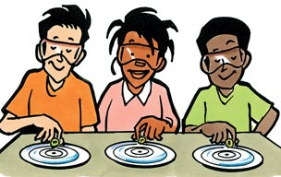
M&M Questions to Investigate
Look at the variables below:
color of M&M’s
number of M&M’s
temperature of water
type of liquid
What question(s) can be investigated by changing
one variable above at a time?
Notes:
Engage/Explore: Tell students these variables can be changed to learn more about M&M’s. Have them work as a team and make a list of questions that could be investigated. Write questions on the board or chart paper and discuss. Tell students they will investigate one of the questions.

Slide 18

Question to Investigate
through an Experiment
(Problem Statement)
Does the temperature of the water
affect how fast the colored
coating dissolves from an M&M?
Adapted from Inquiry in Action Chapter 1 Activity 1.5
Notes:
Explore: Tell students that this is the first question that will be investigated. It will be investigated by the class with each group doing one trial. Each group will share their data collected with the whole class. The investigation will be done in the format of doing a science fair project.
You can click on the hyperlink: Adapted from Inquiry in Action Chapter 1 Activity 1.5 for the original lesson.

Slide 19

Hypothesis
Write your own hypothesis.
If ………………………, then………………..
Notes:
Explore continued: Sample hypothesis: If an M&M is placed in three different temperatures of water, room temperature, cold, and hot water, then the M&M placed in hot water will dissolve the fastest.

Slide 20
Materials
3 Same-color M&M’s
1 White foam dessert plates (with measurements)
Room-temperature water
Hot water
Cold water
Measuring cup
Centimeter ruler
Large container or bowl
Paper towels
Graduated cylinder
Stopwatch
(stopwatch online)
Notes:
Explore continued: Have each group member assigned to a lab role: Project Director (PD), Materials Manager (MM), Technical Manager (TM), and a Safety Director (SD) or a variation of these roles.
Materials Manager will collect the materials and getting the type of water when needed.
Each group needs these materials. You can have a thermos of hot water, a pitcher of cold and room temperature water set up in one location for students use.
Students can use a stopwatch or timer or go online for a stopwatch.

Slide 21
Procedures
Take the temperature of the room temperature water.
Pour 50mL of room-temperature water into the plate.
Place a same-colored M&M in the center of the plate with the help of your partners, and observe for 1 minute. (stopwatch online)
Record the qualitative measurements you see in the 1 min.
Measure the distance in centimeters that the colored coating traveled. (measure from the center).
Record your quantitative observations on the group Data Table Trial #___.
Repeat steps 1-6 with the cold water, then with hot water.
Record your group’s trial data on the class data chart.
Copy the other groups’ trial data.
Find the average for all of the trials and record.
Notes:
Explore/Explain: Students can use a stopwatch or timer or go online for a stopwatch.

Slide 22
Class Data Collection:
Distance Coating Traveled in Centimeters
Trial | Room Temperature Water | Cold Water | Hot Water
#1 | cm | cm | cm
#2 | cm | cm | cm
#3 | cm | cm | cm
#4 | cm | cm | cm
#5 | cm | cm | cm
#6 | cm | cm | cm
Average | cm | cm | cm
Notes:
Explain: Have each group create a graph to display the data.

Slide 23
Share Each Group’s Trial Data
Notes:
Explain/Evaluate: Have students share their data. Ask students whether they noticed a difference in the movement of color in the different temperatures of water. Discuss with students how to write the results on the lab sheet.

Slide 24
Conclusion
What was investigated? (Describe the problem statement.)
Restate your hypothesis, and tell if it was supported or not supported.
What were the major findings? (Explain your evidence.)
Notes:
Explain/Evaluate: Students answer the questions to write a conclusion.

Slide 25
Application
If the experiment was to be repeated should anything be done differently?
Explain what you learned from your experiment that could be applied in a real life situation.
List any new questions that your experiment lead you to ask that could be tested in a new investigation.
Notes:
Explain/Evaluate: Students answer the questions to write an application.

Slide 26
Communicate Your Inquiry
You can use the science fair blank template to create a Power Point presentation.
You can duplicate your Power Point presentation and display on a mini-Science Fair Project Board.
Notes:
Explain/Evaluate: Show students the Science Fair PP template and how to use it.

Slide 27
New M&M Investigation?
Form a new question or state a New Problem on the same topic.
What do you still want to know?
What more can you learn?
Notes:
Extend: Students can do a new M&M investigation.

Slide 28
Scientific Method
Review
Notes:
Use as needed for review and also for Science Fair Background preparation.

Slide 29
1. Ask a Question or State a Problem
Asking WHAT? or HOW? about something you observed
Notes:
Review

Slide 30
2. Research your Topic
Gather information that will help you answer your question.
Library, Internet, Interviews, Experiments
Notes:
Review

Slide 31
3. State your HYPOTHESIS
A Hypothesis is an explanation for a question that can be formally tested.
An educated guess!
If…then…
Notes:
Review

Slide 32
4. Design an Experiment
A procedure is a set of directions designed to test your Hypothesis… Is it is true or false.
A procedure must be repeatable, and easy to understand for others to duplicate.
Each procedure step needs to be numbered.
Each step needs to begin with a verb.
Figure out and collect the materials needed for the experiment.
Notes:
Review

Slide 33
Step 4 Planning Continued
Write your procedures or the steps you will
follow in your experiment.
Each procedure step needs to be numbered.
Each step needs to begin with a verb.
These procedures will insure that all variables are kept the same (constant) or controlled except the one you are testing.
Figure out and collect the materials needed for the experiment.
Notes:
Review

Slide 34
In a well designed Experiment, you need to keep all variables the same except one.
Test/Independent/Manipulated Variable: (CAUSE)
The factor that is changed in an experiment…it is what you are testing!
Constant/Controlled Variable(s):
The factor(s) that remains the same!
Outcome/Dependent/Responding Variable: (EFFECT) The data you collect
Notes:
Review

Slide 35

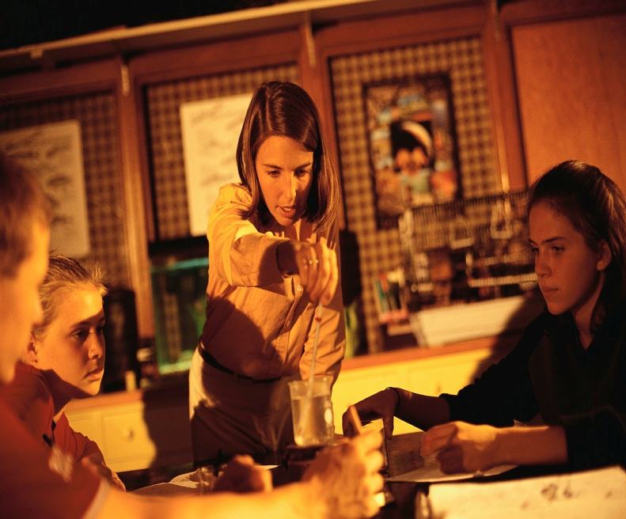
5. Conduct your Experiment
Perform your experiment by following your written procedure.
Be sure to follow all safety rules!
Notes:
Review

Slide 36
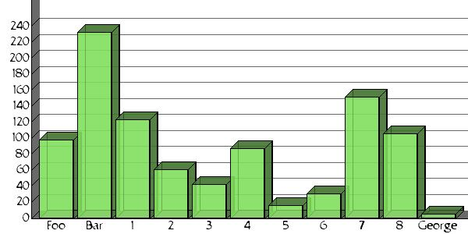
6. Collect Data
The observations and measurements you make in an experiment are called Data.
Notes:
Review

Slide 37
7. Analyze Data
Did your experiment support your hypothesis?
What happened during your experiment?
Does additional research need to be conducted?
Notes:
Review

Slide 38
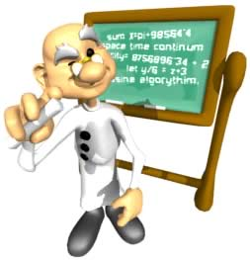
8. Conclusion
Does your data and observations support your hypothesis?
“My hypothesis was
(supported or not supported)
because __________”
Notes:
Review

Slide 39

9. Communication
Share your results and data with others.
Sources: written, spoken, video, TV, papers, lecture . . .
Notes:
Review

Slide 40
Communicate Your Inquiry
You can use the science fair blank template to create a Power Point presentation.
You can duplicate your Power Point presentation and display on a Science Fair Project Board.
Notes:
Review
Click on hyperlink: science fair blank template to show students a resource they can modify to create their own science investigation presentation.

Slide 41
10. New Problem
Form a new question or state a New Problem on the same topic.
What more can you learn?
What do you still want to know?
Notes:
Review

Slide 42
Think Like a Scientist!
Ask questions Investigate
Observe Experiment
The Science Fair is Coming!

Slide 43
Scientific Method - Resource Links
http://www.inquiryinaction.org/(Inquiry in Action Chapter 1 Molecules in Motion : Activities 1.1 and 1.5)
http://studyjams.scholastic.com/studyjams/jams/science/scientific-inquiry/scientific-methods.htm
http://glencoe.mcgraw-hill.com/sites/0078600472/student_view0/brainpop_movies.html#
Experiment Vocabulary
http://app.discoveryeducation.com/core:glossary/?assetGuid=15b534cf-207d-46bb-aa6a-ce75376b4541&blnAllWords=1&#/173110e1-543e-455d-be65-7761175b7f8e
http://app.discoveryeducation.com/core:glossary/?assetGuid=15b534cf-207d-46bb-aa6a-ce75376b4541&blnAllWords=1&#/173110e1-543e-455d-be65-7761175b7f8e
Control
http://app.discoveryeducation.com/player/?assetGuid=ff8f973d-8699-47b6-a3f0-cce1c5794f5d&fromMyDe=0&isPrinterFriendly=0&provider=&isLessonFromHealth=0&productcode=DSCE&isAssigned=false&includeHeader=YES&homeworkGuid=
Experiment
http://app.discoveryeducation.com/player/?assetGuid=df901eaa-9a26-4d22-b589-da77dab08a6e&fromMyDe=0&isPrinterFriendly=0&provider=&isLessonFromHealth=0&productcode=DSCE&isAssigned=false&includeHeader=YES&homeworkGuid=
http://app.discoveryeducation.com/player/view/assetGuid/DF901EAA-9A26-4D22-B589-DA77DAB08A6E
Thinking Like a Scientist
http://app.discoveryeducation.com/player/?assetGuid=11d5de3c-fdb4-4ed3-8975-99da3cbd1357&fromMyDe=0&isPrinterFriendly=0&provider=&isLessonFromHealth=0&productcode=US&isAssigned=false&includeHeader=YES&homeworkGuid=
http://app.discoveryeducation.com/player/view/assetGuid/78D4AE32-97F3-4326-835F-831CB751135F
Notes:
Resources on line

