Slide 1

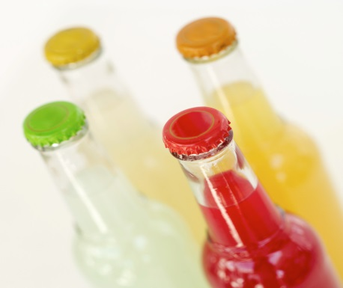
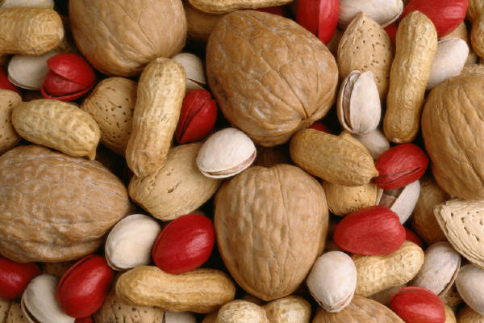
Physical Science
Big Idea 8: Properties of Matter
Grade 5 Quarter 1 Topic 4
Mixtures and Solutions
Mary Tweedy, Curriculum Support Specialist
Keisha Kidd, Curriculum Support Specialist
Dr. Millard Lightburn, Instructional Supervisor

Slide 2
Quarter 1 Topic 4:
Mixtures and Solutions
Benchmarks
SC.5.P.8.3 Demonstrate and explain that mixtures of solids can be separated based on observable properties of their parts such as particle size, shape, color, and magnetic attraction.
SC.5.N.1.1 Define a problem, use appropriate reference materials to support scientific understanding, plan and carry out scientific investigations of various types such as: systematic observations, experiments requiring the identification of variables, collecting and organizing data, interpreting data in charts, tables, and graphics, analyze information, make predictions, and defend conclusions.
SC.5.N.2.1 Recognize and explain that science is grounded in empirical observations that are testable; explanation must always be linked with evidence.
LACC.5.SL.1.1 Engage effectively in a range of collaborative discussions (one-on-one, in groups, and teacher-led) with diverse partners on grade 5 topics and texts, building on others’ ideas and expressing their own clearly.

Slide 3
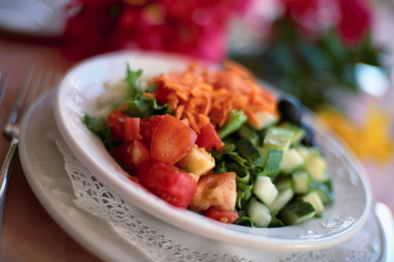
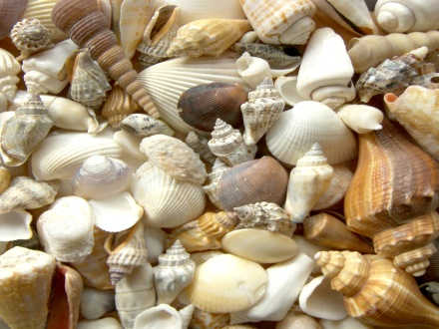
What do you know about mixtures?
Form when two or more substances combine.
Keep their physical properties.
Can be separated by their physical properties.
Notes:
Engage: 1. Ask students what they know about mixtures.
2. Pass out a small sample (tablespoon full) of trail mix or Chex Mix to each student to
observe. Ask the following: Is this is a mixture? Why or why not? What are some
ways this mixture could be separated? Tell students to separate their mixture. Then
discuss how the mixtures were separated. (Using color, shape, and type of food, etc.
properties.)
Explain: Click on hyperlink mixtures for a video on mixtures.

Slide 4
What are some physical properties of matter?
Color
Texture
Odor
Size
Volume
Mass
Solid, Liquid, or Gas
Magnetic
Floats or sinks
Boiling point
Melting point
Notes:
Explain

Slide 5
Salad is an example of a mixture
The lettuce and vegetables do not change when mixed
Notes:
Explain: Show a picture of a salad. Ask is a salad a mixture. (Yes, the lettuce and
vegetables do not change when mixed.)

Slide 6
Is cereal a mixture?
Yes…the properties of the substances do not change.
You can still see the bananas, cereal, and milk.
Notes:
Explain: Show a picture of a bowl of cereal or a real bowl of cereal in milk. Ask is cereal a
mixture. (Yes, the properties of the substances do not change. You can still see the
cereal and milk.) Say substances in a mixture can be separated by their
physical properties. So how can we separate this mixture? (Milk and cereal can be
separated by pouring the mixture through a strainer. The cereal would be trapped in
the strainer and the milk would pass through.)

Slide 7
Substances in a mixture can be separated by their physical properties… So how can you separate this mixture?
Milk and cereal can be separated by pouring the mixture through a strainer.
Notes:
Explore: So how can we separate this mixture? (Milk and cereal can be
separated by pouring the mixture through a strainer. What would happen?

Slide 8
The cereal would be trapped in the strainer and the milk would pass through.
Notes:
Explain

Slide 9
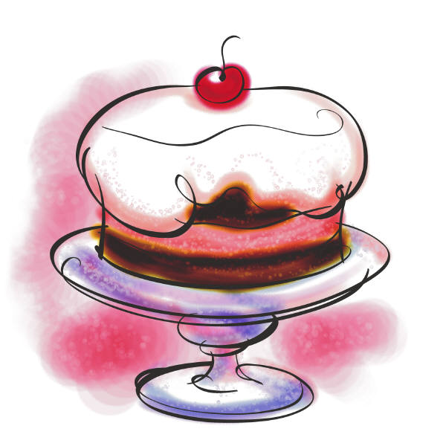
Is cake a mixture?
No…the properties of the substances change.
The eggs, flour, and sugar change when the cake is mixed and baked.
Notes:
Explain: Show a picture of a cake and ask is a cake a mixture. (No, the properties of the
substances change. The eggs, flour, and sugar change when the cake is mixed and
baked.) What kind of change took place? (Yes, it’s a chemical change.)

Slide 10
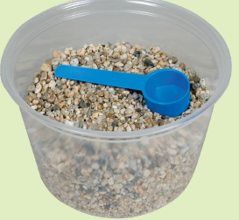

QUESTION:
Which scientific tool could you use to separate a mixture of iron filings and gravel?
Hint: What is a property that iron
has and gravel doesn’t?
Notes:
Explore: Show a bag filled with a mixture of iron filings and gravel. Then ask the question. Then have a student volunteer demonstrate separating the mixture with a magnet.

Slide 11
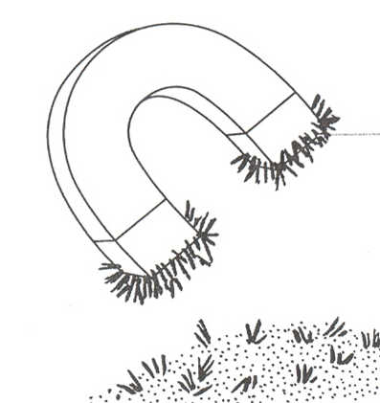
ANSWER:
Iron is magnetic.
You can separate the iron filings from the gravel by using a magnet.
Iron filings
Notes:
Explain

Slide 12
What do you know now about mixtures?
Form when two or more substances combine.
Keep their physical properties.
Can be separated by their physical properties.
Do not form a new substance.
Notes:
Explain: Ask students again what they know about mixtures. (Form when two or more
substances combine. Keep their physical properties. Can be separated by their
physical properties. Do not form a new substance.)

Slide 13
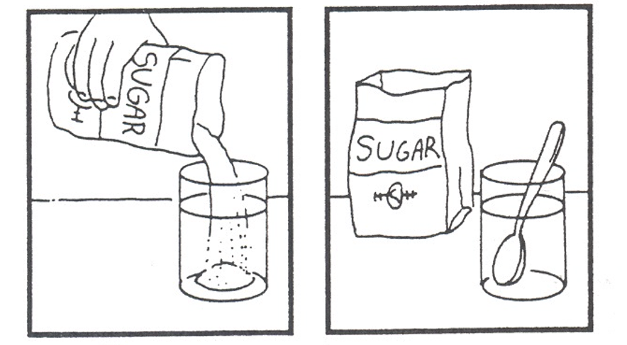
You can make a special mixture when you stir sugar into water.
What did you notice about this mixture?
The water remained clear and the sugar seemed to disappear.
Notes:
Explore: Call on a volunteer to help you mix a teaspoon of sugar in the cup of water. Then ask what happened to the sugar? Then ask is this a mixture?
(Yes, it’s a special kind of mixture called a solution.)

Slide 14
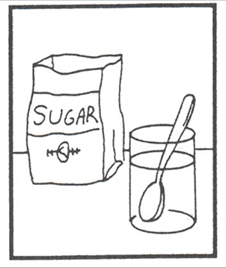
What are these special kind of mixtures called?
A solution
The sugar spread out evenly and dissolved in the water.
Notes:
Explain: What are solutions? (Solutions are when one of the substances in the mixture
spreads out evenly and dissolves in the other. Solutions are a special kind of mixture.)

Slide 15
What are solutions?
One of the substances spreads out evenly or dissolves in the other
Solutions are a special kind of mixture
Notes:
Explain: What are solutions? (Solutions are when one of the substances in the mixture
spreads out evenly and dissolves in the other. Solutions are a special kind of mixture.)

Slide 16
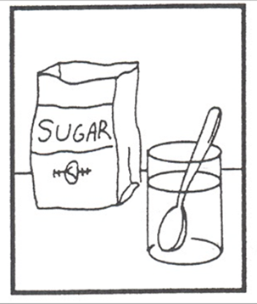
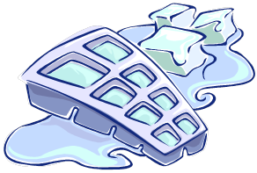
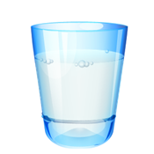
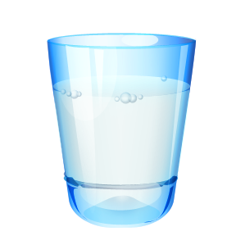
What can be done to speed up or slow down the dissolving process?
Increase the number of and/or force of the stirs.
Change the temperature of the substances being mixed.
Notes:
Explain

Slide 17
Solutions are a special kind of mixture
One of the substances
dissolves in the other
The substance spreads out evenly
Solutions may be clear or colored
Notes:
Explain

Slide 18
Solutions can be separated
To separate a sugar water solution, let the water evaporate.
Once the water is gone, the sugar will be left.
Most solutions can be separated by evaporation.
Notes:
Explain: How could we separate a solution of sugar and water?

Slide 19
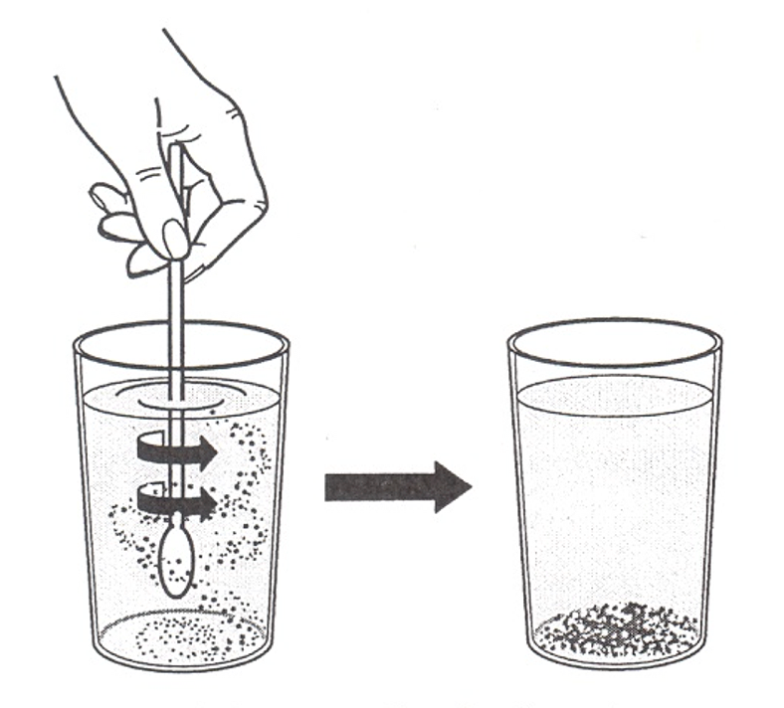
Do all substances dissolve in liquids?
Observe as sand is mixed with water.
What happened?
The sand doesn’t dissolve and it settled on the bottom of the glass.
Sand + water
Notes:
Explore: Show question in slide. Then ask what happens if sand is mixed with water. Demonstrate: Call on a volunteer to pour a spoonful of sand into a cup of water. Ask what happened. Ask: Does mixing sand and water make a mixture? (yes) Is this a special mixture that is also called a solution?
No. What is the evidence? How can we separate this mixture? ( pour through a coffee filter)

Slide 20
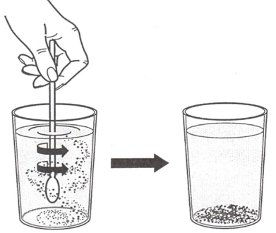
All solutions are mixtures but not all mixtures are solutions
Sugar + Water = ?
mixture and a solution
Sand + Water = ?
mixture but not a solution
sand + water
Notes:
Explain

Slide 21



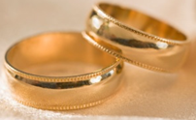
What do all solutions have in common?
One of the substances in the mixture dissolves in the other substance.
Both substances in the solution retain their properties and can be separated.
Notes:
Explain/evaluate

Slide 22


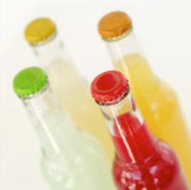
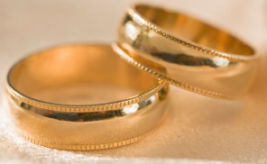
What are some other examples of solutions?
Air = 21% Oxygen + 78% Nitrogen + 1% other gases
Ocean water
Swimming pool water
Soda = Water+ CO2 + other flavors
Jewelry = gold + nickel
Notes:
Explore/Explain: Click on hyperlink: solutions to watch a video.

Slide 23


Let’s Explore
Observe the mystery mixture in the bag without opening the bag.
What do you think is in this mixture?
How can it be separated?
Brainstorm with your group a
plan to separate this mixture?
Be ready to share your ideas with the class.
Notes:
Explore: A head of time fill a plastic lunch baggy with one level spoonful of salt, sand and
gravel for each of class groups. Shake up the bags. Give each group a bag and tell them not to open it. Ask them to observe the mixture and make a hypothesis about what three substances could be in the mixture. Then ask to work with their group to brainstorm ideas and materials that could be used to separate the mixture. Their hypothesis and ideas for separating should be written in their notebook.

Slide 24
What materials/tools will you use to separate the mystery mixture?
2 Clear plastic cups
Graduated cylinder
50 mL of water
Wire mesh screen
or strainer*
1 Spoon
Paper towels
Hand lens
Filter paper or coffee filter
Notes:
Explain

Slide 25

Have your group’s Materials Manager get the lab materials and give the Separating a Mixture Lab a try.
Notes:
Explore

Slide 26
Explain
1. Were you able to separate the mixture?
2. Were there any problems?
What did you do to ensure that the results
were accurate?
What substances were separated and
identified?
5. Does the evidence support your prediction?
Notes:
Explain/evaluate

Slide 27

Elaborate
Essential Lab # 1: separating sALT,
sAND and Iron Filings
Essential Lab 1 Separating Salt, Sand and Iron Filings (Student)
Essential Lab 1 Separating Salt, Sand and Iron Filings (Teacher)
Notes:
Click on the hyperlink: http://science.dadeschools.net/elem/instructionalResources.html. Open up Grade 5 Essential Lab Quarter 1 and scroll down to Essential Lab # 1: sEPARATING sALT, sAND and Iron Filings.

Slide 28

Brain Check
What is a mixture? Give two examples.
What is a solution? Give two examples.
How do you know when a solid and a liquid form a mixture that is also a solution?
How can mixtures be separated?
How are screen filters and paper filters alike? How are they different?
Notes:
Evaluate

Slide 29
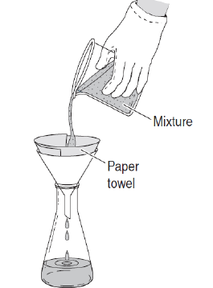
Brain Check continued
6. The beaker has a mixture of sugar, sand, and water in it? Which material will collect on the paper towel filter? Explain your answer.
Notes:
Evaluation continued

Slide 30
Mixtures and Solutions Review
1. What are mixtures?
Answer: A combination of two or more substances that can be separated from the mixture and be the same as they were before they were mixed.
Examples will vary… cereal, salad, gravel, etc.
2. What are solutions?
Answer: A mixture in which all parts are mixed evenly. They can be combinations of gases, liquids, and even solids.
Examples will vary… air, tea with sugar,

Slide 31
Mixtures and Solutions
Resources
Solutions
http://www.harcourtschool.com/activity/mixture/mixture.html
http://www.chem4kids.com/files/matter_solution.html
http://www.chem4kids.com/files/matter_mixture.html
http://www.chem4kids.com/files/matter_mixtureex.html
Notes:
Resources

